Slide 1
Distilling Vision-Language Models on Millions of Videos
Presenter: Kim Seung Hwan (seunghwan.kim@snu.ac.kr)

Slide 2
Paper
Distilling Vision-Language Models on Millions of Videos
Zhao et al.
CVPR ’24

Slide 3
Problem
(Image) VLM has emerged, due to abundant image-text dataset
Video-Language Model cannot reproduce
Since current video dataset is lacking in number of data
and/or has poor caption, due to high labeling cost
Analyzing video with image VLM alone is biased towards “static”

Slide 4
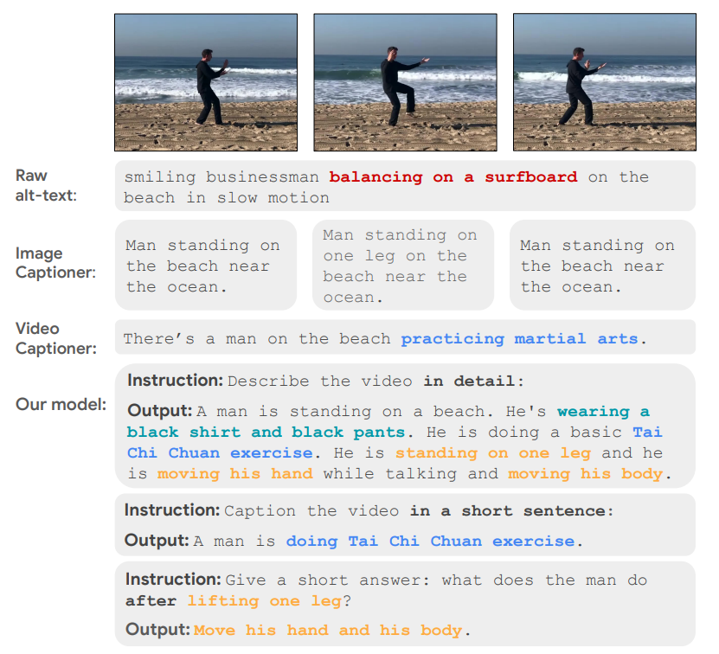
Problem

Slide 5
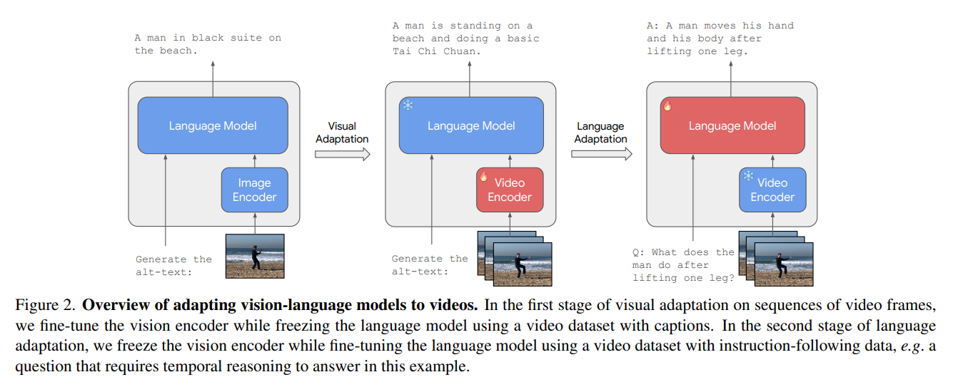
Concept
Fine-tuning pretrained image VLM for the video domain
Via two-stage training, using different datasets

Slide 6
Concept
First, train VE while freezing LM, with big but poor caption data
Second, train LM while freezing VE, with small but annotative data

Slide 7
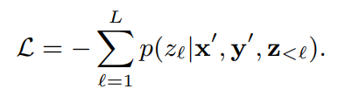
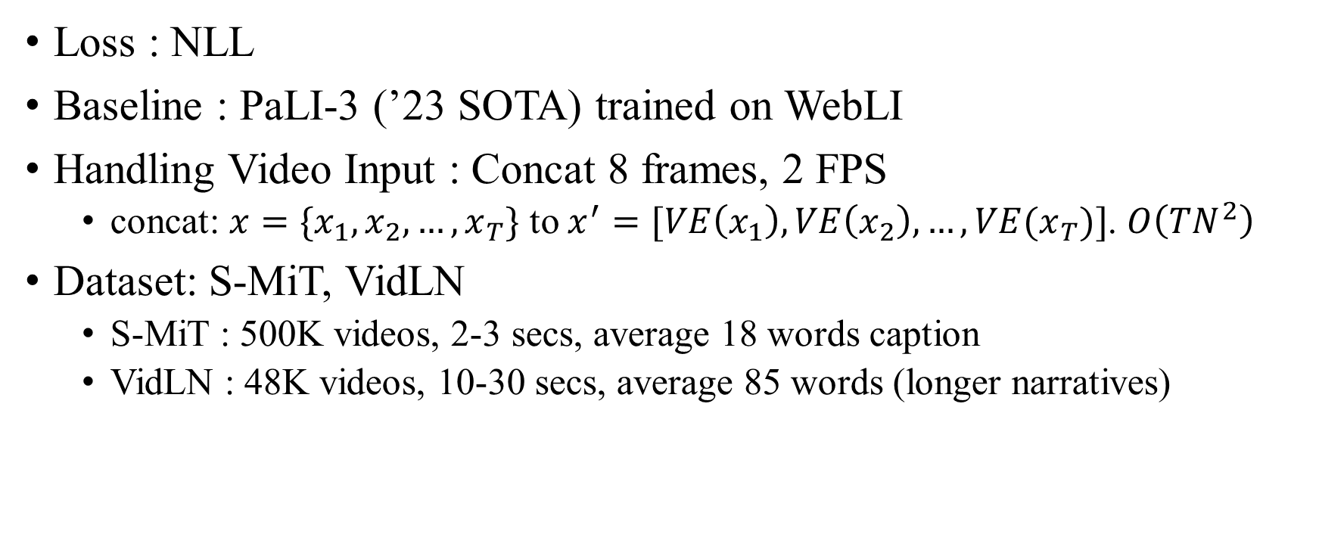
Details
Loss : NLL
Baseline : PaLI-3 (’23 SOTA) trained on WebLI
Handling Video Input : Concat 8 frames, 2 FPS
concat: $x=\{x_{1},x_{2},…, x_{T}\}$ to $x^{′}=[VE\left(x_{1}\right), VE\left(x_{2}\right), …,VE(x_{T})]$. $O\left(TN^{2}\right)$
Dataset: S-MiT, VidLN
S-MiT : 500K videos, 2-3 secs, average 18 words caption
VidLN : 48K videos, 10-30 secs, average 85 words (longer narratives)

Slide 8
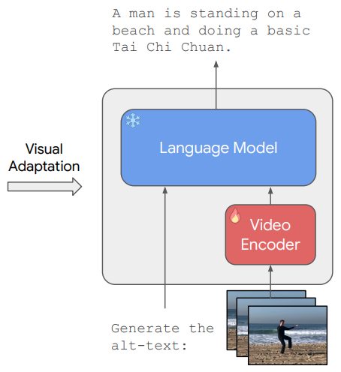
Video Adaptation
In the first stage, they train VE while freezing LM
The task is captioning, i.e. y=“Generate the alt-text:”
Using S-MiT, i.e. short caption data
They want VE to focus on scene dynamics,
Maintaining LM’s ability

Slide 9
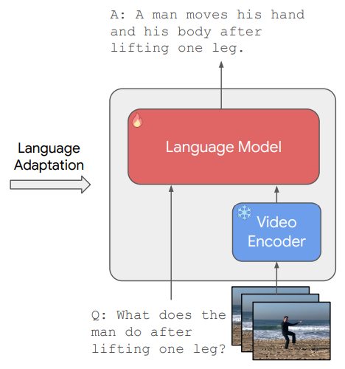
Language Adaptation
In the second stage, they train LM while freezing VE
They generate temporal/causal questions with LLMs
e.g. “Why did somebody do something?”,
or “How did something happen?”

Slide 10
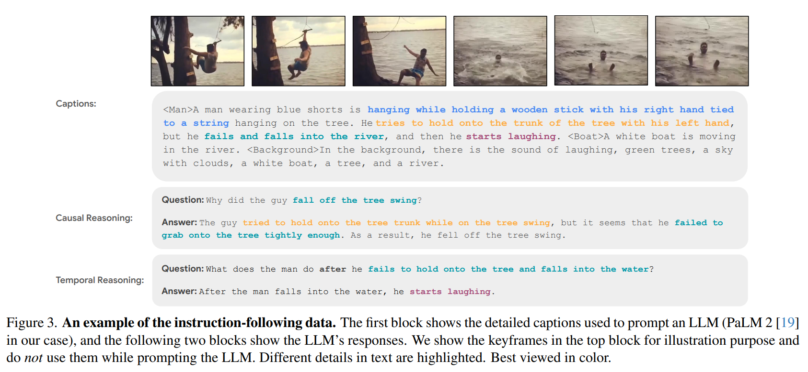
Language Adaptation

Slide 11
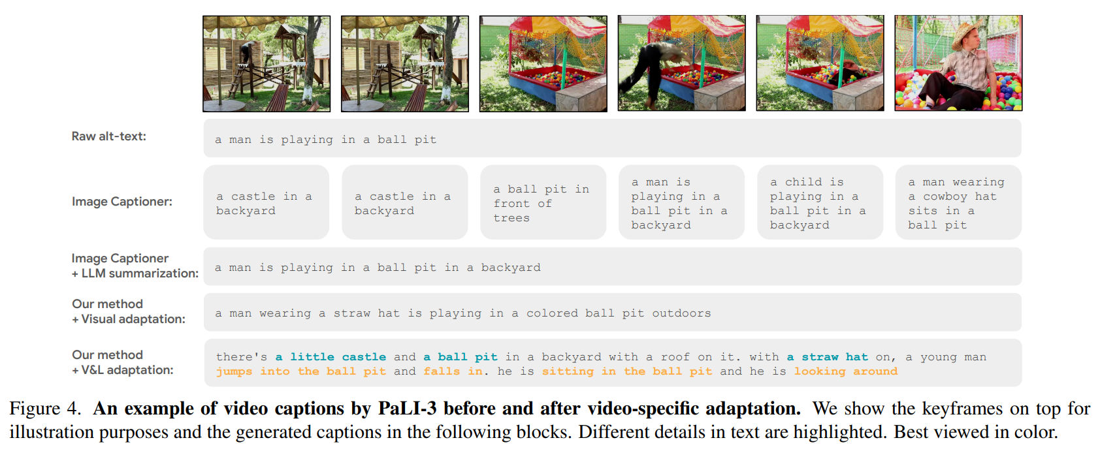
Experiment
Zero-shot performance of adapted VLM
Pseudo-captioning on web-scale dataset, i.e. Distillation

Slide 12
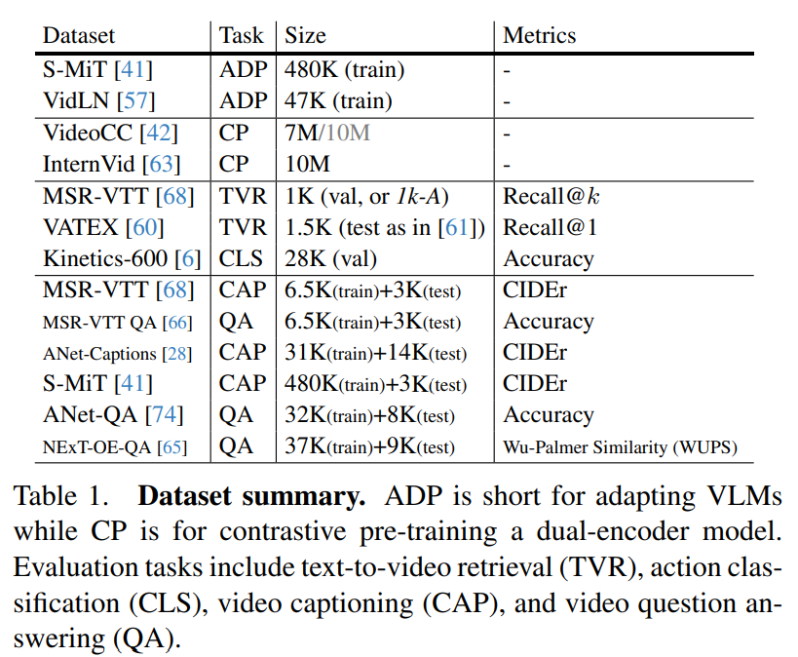
Results

Slide 13
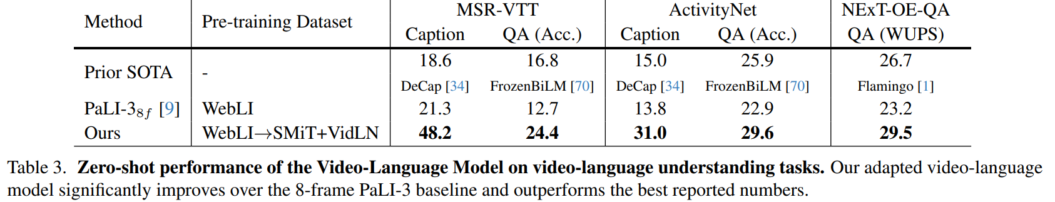
Results

Slide 14
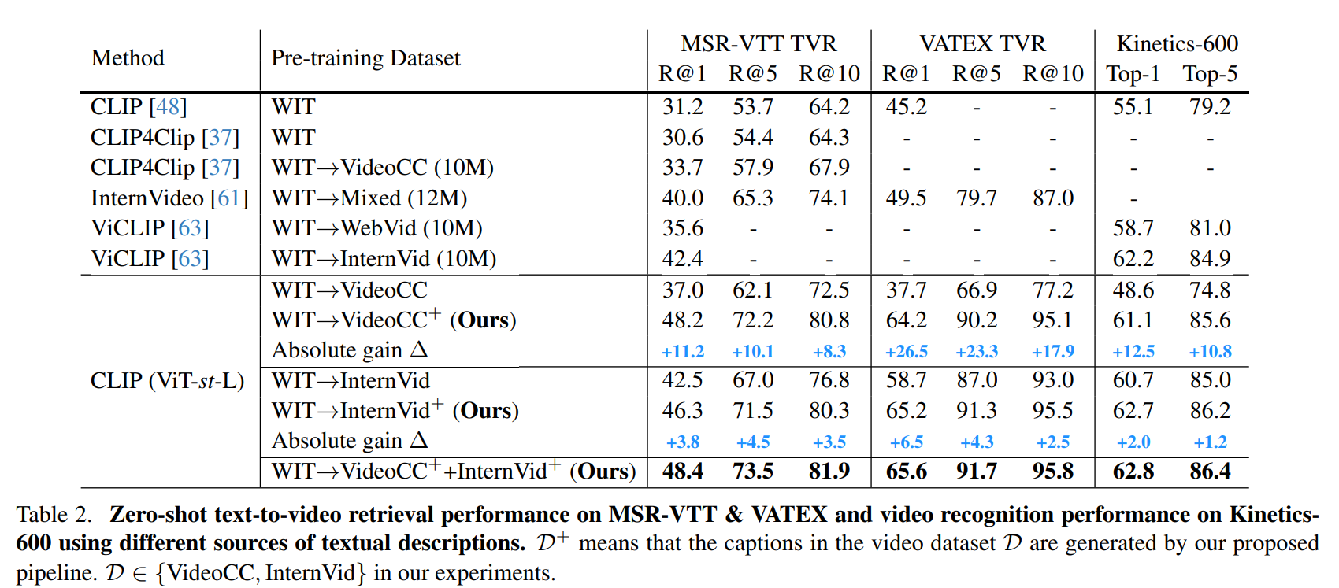
Results

Slide 15
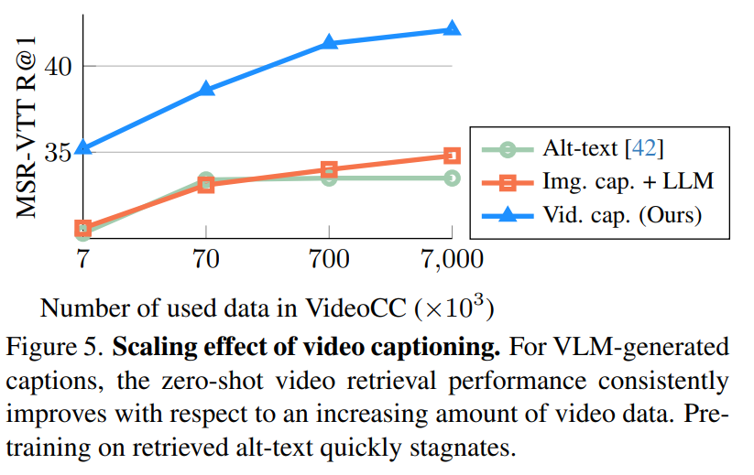
Results

Slide 16
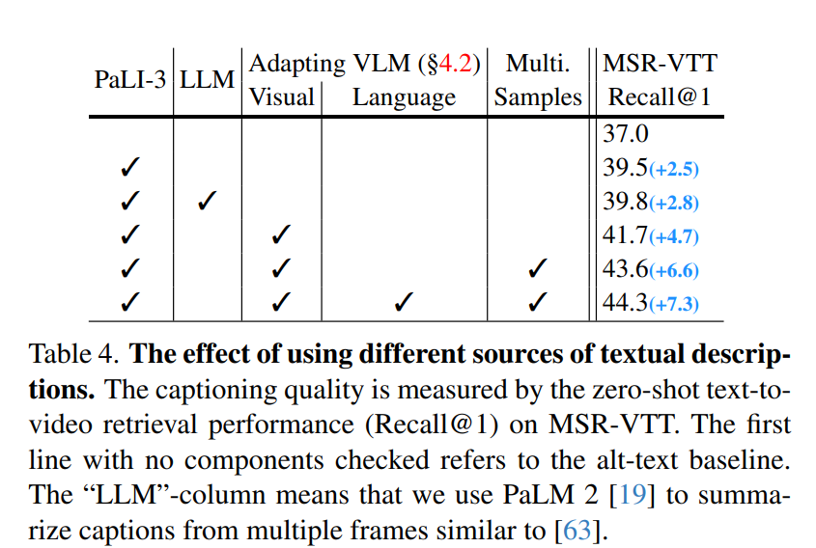
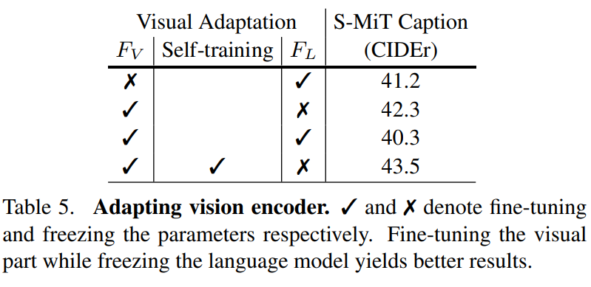
Ablation Study

Slide 17
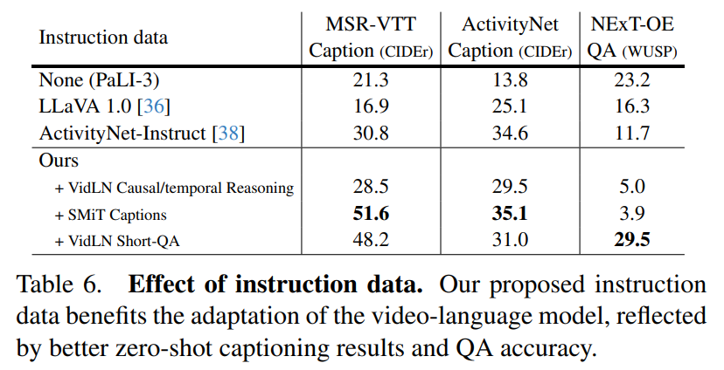
Ablation Study

Slide 18
Takeaway
Rich annotations are expensive but important
This seems to align with recent research
This is an example of how to leverage relatively scarce video datasets
Distilled by captioning

Slide 19
Thoughts
They use very simple two-stage training
It is not a fancy method – it would be less useful if we have better data
Yet it is clever, compensating for the shortcomings of existing dataset

Slide 20
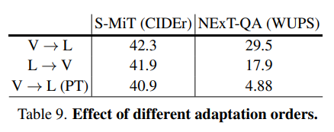
Curiosity
The idea of freezing LM to train on data with poor caption is great
Also, it makes sense to train the VE before LM, and the experimental results support it
But why freeze VE when training on good data?

Slide 21
Thank you for listening
Presenter: Kim Seung Hwan (seunghwan.kim@snu.ac.kr)

